Slide 1

19ECC01 – COMPUTER ARCHITECTURE AND ORGANIZATION

Slide 2
UNIT III - CONTROL DESIGN
Hardwired Control
Classical Method
One–hot method
Microprogrammed Control
GCD Processor
Multiplier Control Unit
CPU Control Unit
Pipeline Control
Instruction Pipelines
Pipeline Performance
Superscalar Processing
Nano Programming

Slide 3
UNIT II - DATA PATH DESIGN
Introduction:
Digital system has two parts
A Datapath (Data Processing) Unit:
The datapath is a network of functional and storage units capable of performing certain (micro) operations on data words.
A Control Unit:
The control unit is to issue control signals to the datapath.
These control signals enter the datapath at "control points" where they select the functions to be performed at specific times and route the data through the appropriate parts of the datapath unit.
In other words, the control unit logically reconfigures the datapath to implement some specified instruction or program.

Slide 4
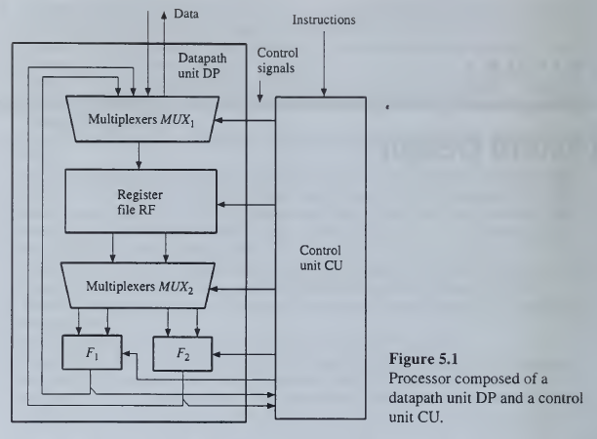
UNIT II - DATA PATH DESIGN
Introduction: General Structure of Processor
It contains a register file RF for temporary storage of operands, two functional units F₁ and F₂ responsible for data processing, and multiplexers to allow the data to be steered through DP.
Typical functional units are an ALU performing addition, subtraction, and logical operations; a shifter; or a multiplier.
The control unit CU receives external instructions or commands, which it converts into a sequence of control signals that the CU applies to DP to implement a sequence of register transfer operations.

Slide 5
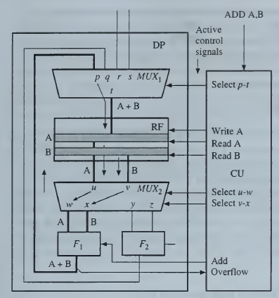
UNIT II - DATA PATH DESIGN
Introduction:
The processor configured to implement the add operation A := A + B.

Slide 6
UNIT II - DATA PATH DESIGN
Introduction:
The processor configured to implement the add operation A := A + B.
Assume that this operation can be executed in a single clock cycle, whose timing details are not of concern at this level of abstraction.
The input variables A and B are obtained from registers of the same name in RF, and the result is stored back into register A.
Observe that the registers of RF permit their contents to be read from and written into in the same clock cycle, a basic property of the (edge-triggered) flip-flops from which such registers are constructed.
Besides selecting the data registers to be used, the control unit CU must also select the operation to be performed on the data, in this case, functional unit F₁'s ADD operation.
Finally the necessary logical connections for the data to flow through DP must be established by applying appropriate control signals to the multiplexers.
Thus we see that CU must activate the following three types of control signals during the clock cycle in which the ADD A,B instruction is executed.
Function select: Add.
Storage control: Read A, Read B, Write A.
Data routing: Select p-t, Select u-w, Select v-x
The functional unit F, performing the addition sends an overflow signal to CU whenever the sum A + B exceeds the normal word size.

Slide 7
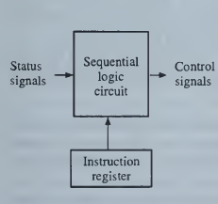
UNIT II - DATA PATH DESIGN
Introduction:
Implementation Methods
Hardwired Implementation:
The controller as a sequential logic circuit or finite-state machine that generates specific sequences of control signals in response to externally supplied instructions.
It is designed with the minimum number of components used.
Maximum speed of operation.
Once the unit is constructed, the only way to implement changes in control-unit behavior is by redesigning the entire unit. Not flexible.

Slide 8
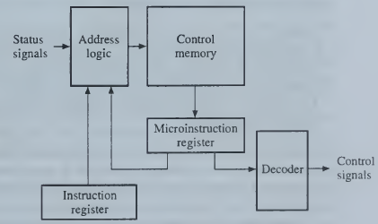
UNIT II - DATA PATH DESIGN
Introduction:
Implementation Methods
Microprogrammed Implementation:
It is built around a storage unit called a control memory, where all the control signals are stored in a program like format. The control memory stores a set of microprograms designed to implement or emulate the behavior of the given instruction set. Each instruction causes the corresponding microprogram to be fetched and its control information extracted in a manner that resembles the fetching and execution of a program from the computer's main memory. This is referred to as firmware.
Design changes can be easily made just by altering the contents of the control memory.
Microprogrammed control units are more costly to manufacture than hardwired units due to the presence of the control memory and its access circuitry.
Microprogrammed units also tend to be slower because of the extra time required to fetch microinstructions from the control memory.

Slide 9
UNIT II - DATA PATH DESIGN
Basic Concepts:
Hardwired Control - Methods
Method 1: The classical method
It attempts to minimize the amount of hardware, in particular, by using only ┌log₂P┐flip-flops to realize a F-state circuit.
High Design Complexity.
Less Hardware resources required.
Method 2: One-Hot Method
P number of flip-flops, where P=number of states.
Low Design Complexity.
More Hardware required and its occupied more space.

Slide 10
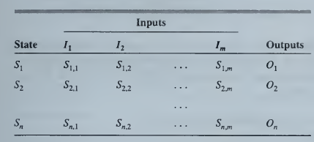
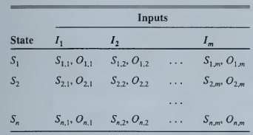
UNIT II - DATA PATH DESIGN
Basic Concepts:
Hardwired Control – State Tables
Moore machine:
Their output signal values often depend on the current state S_{i}, only and so are independent of the input combination I_{j}.
Mealy machine:
Their output signal values often depend on the current state S_{i}, and input combination I_{j}.
Moore machine
Mealy machine

Slide 11
UNIT III – CONTROL UNIT DESIGN
GCD (Greatest Common Divisor) Processor:
A special-purpose processor that computes the greatest common divisor gcd(X,Y) of two positive integers X and Y.
gcd(X,Y) is defined as the largest integer that divides exactly into both X and Y.
For example, gcd (12, 18) = 6, and gcd (12, 17) = 1.
It is customary to assume that gcd(0,0) = 0.
The basic idea is to subtract the smaller of the two numbers from the other repeatedly—recall that division corresponds to repeated subtraction—until we obtain a number that divides the other.

Slide 12
UNIT III – CONTROL UNIT DESIGN
GCD (Greatest Common Divisor) Processor:
Algorithm
If X_{R} > 0; then,
if X_{R} > Y_{R} then do Subtraction: X_{R} = X_{R} – Y_{R}
Else if X_{R} ≤ Y_{R} then do Swap and Subtraction:
X_{R} = Y_{R} & Y_{R} = X_{R}; X_{R} = X_{R} – Y_{R}
Else X_{R} < 0; then Z = Y_{R}; End

Slide 13
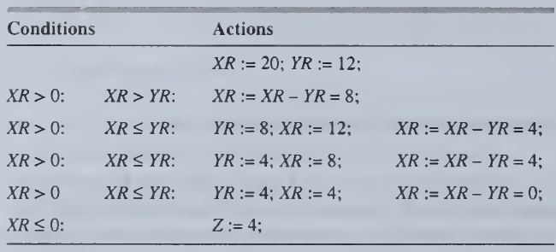
UNIT III – CONTROL UNIT DESIGN
GCD (Greatest Common Divisor) Processor:
Example: X=20 and Y=12

Slide 14
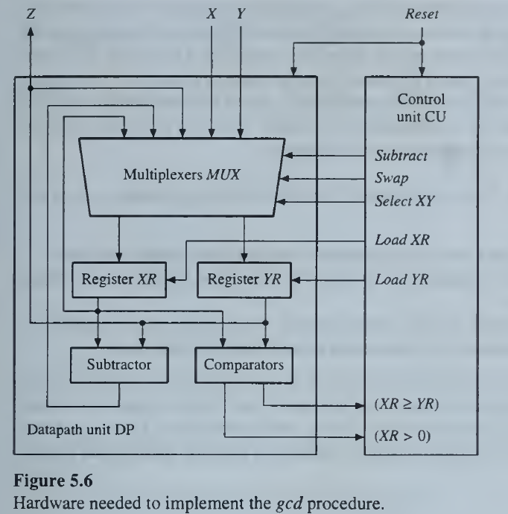
UNIT III – CONTROL UNIT DESIGN
GCD (Greatest Common Divisor) Processor:
Hardware
Architecture

Slide 15
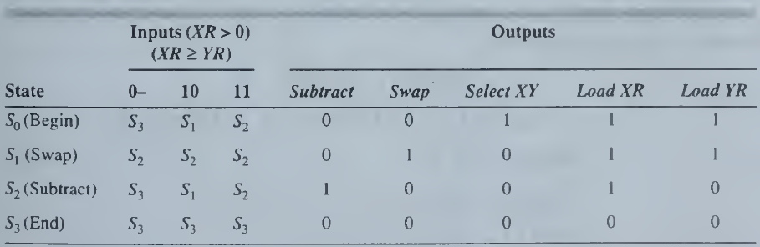
UNIT III – CONTROL UNIT DESIGN
GCD (Greatest Common Divisor) Processor:
State Table for the Control Unit

Slide 16
UNIT III – CONTROL UNIT DESIGN
GCD (Greatest Common Divisor) Processor:
Implementation – Classical Method
Construct a P-row state table that defines the desired input-output behavior.
Select the minimum number p of D-type flip-flops and assign a p-bit binary code to each state.
Design a combinational circuit C that generates the primary output signals {z_{i}} and the secondary outputs {D_{i}} that must be applied to the flip-flops.
Since there are four states, we require two flip-flops, whose outputs D₀D₁ = y₁y₀ define CU's internal states.
S₀ = 00
S₁ = 01
S₂ = 10
S₃ = 11

Slide 17
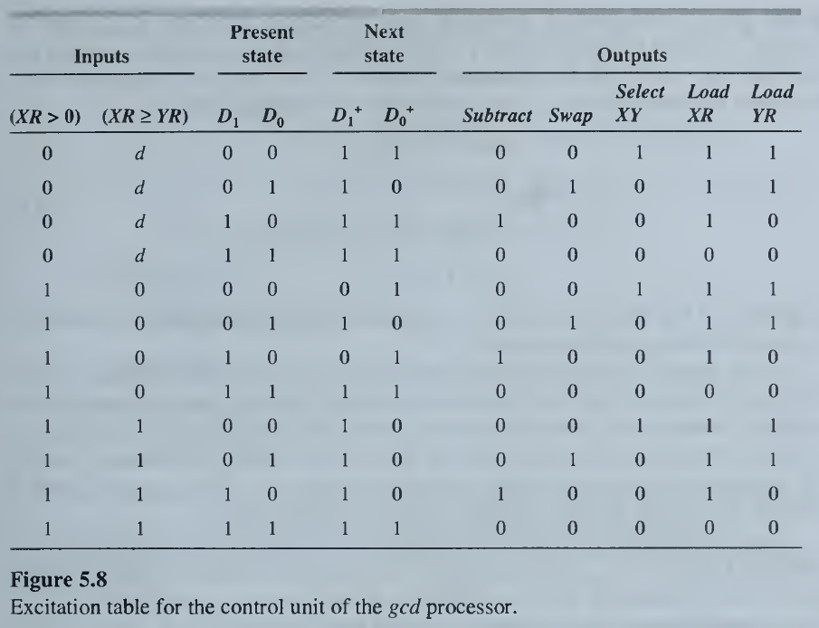
UNIT III – CONTROL UNIT DESIGN
GCD (Greatest Common Divisor) Processor:
Implementation – Classical Method – Excitation Table

Slide 18
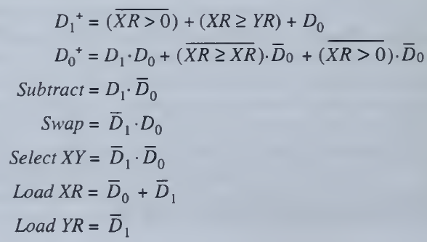
UNIT III – CONTROL UNIT DESIGN
GCD (Greatest Common Divisor) Processor:
Implementation – Classical Method – Boolean Output Expression

Slide 19
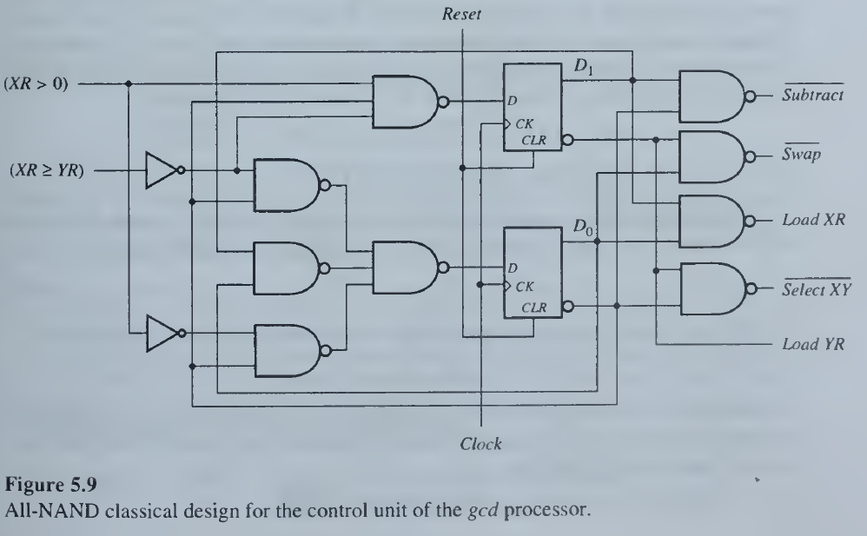
UNIT III – CONTROL UNIT DESIGN
GCD (Greatest Common Divisor) Processor:
Implementation – Classical Method – Circuit Diagram

Slide 20
UNIT III – CONTROL UNIT DESIGN
GCD (Greatest Common Divisor) Processor:
Implementation – One Hot Method
Disadvantage of Classical Method:
The classical design method minimizes a control unit's memory elements, its effect on the amount of combinational logic C is less obvious.
Furthermore, control units designed by this technique tend to have a complicated, "random" structure, which makes design debugging and subsequent maintenance of the circuit difficult.
A simplified design process and gives C a regular and predictable structure, is the one-hot method, so called because its binary state assignment always contains a single ‘1’ the “hot" bit—while all the remaining bits are 0.
Thus the state assignment for a four-state machine like the gcd processor takes the following form,
S₀ = 0001
S₁ = 0010
S₂ = 0100
S₃ = 1000
In general, P -flip-flops are needed to represent P states, so the one-hot method is restricted to fairly small values of P.

Slide 21
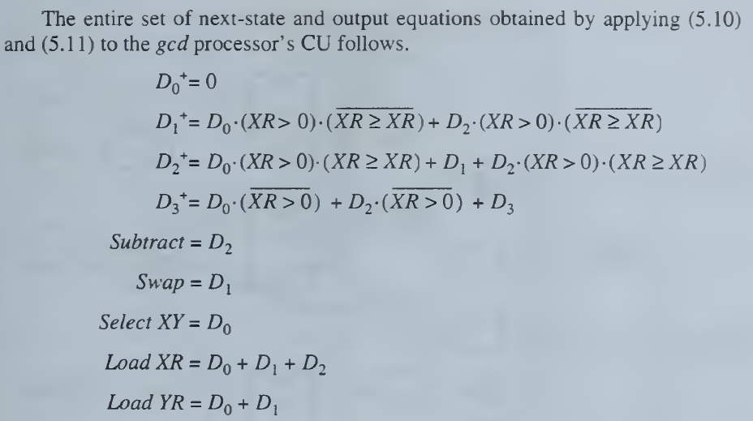
UNIT III – CONTROL UNIT DESIGN
GCD (Greatest Common Divisor) Processor:
Implementation – One Hot Method – Boolean Output Expressions
A key feature of this technique is that the next-state and output equations have a simple, systematic form and can be written down directly from the control unit‘s original symbolic state table. Because the binary pattern assigned to each state is, in effect, fully decoded, we can find out whether the machine is in state S, merely by inspecting the corresponding hot state variable D_{i}.

Slide 22
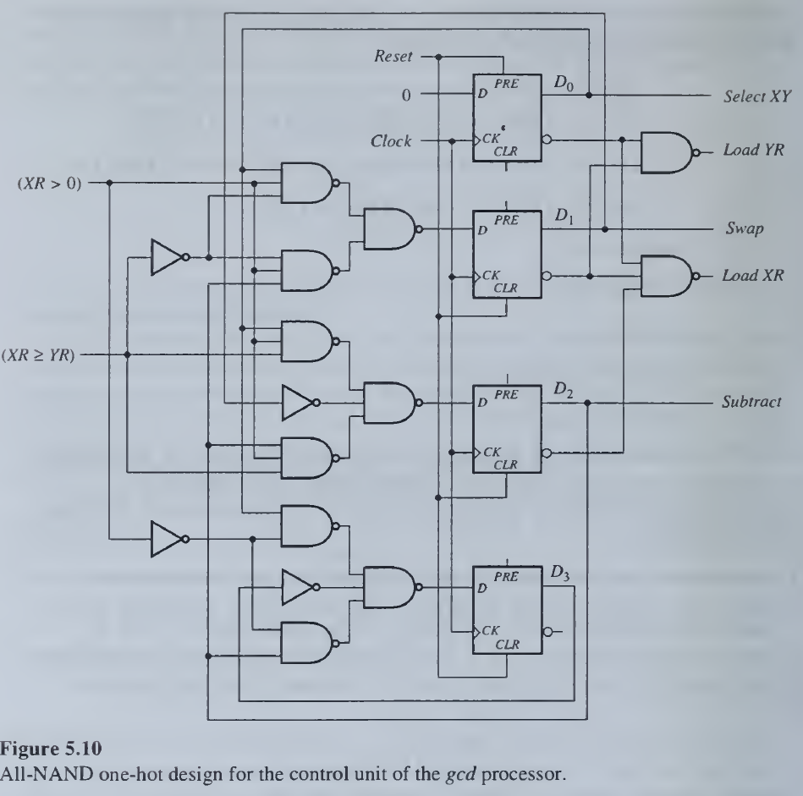
UNIT III – CONTROL UNIT DESIGN
GCD (Greatest Common Divisor) Processor:
Implementation – One Hot Method – Boolean Output Expressions

Slide 23
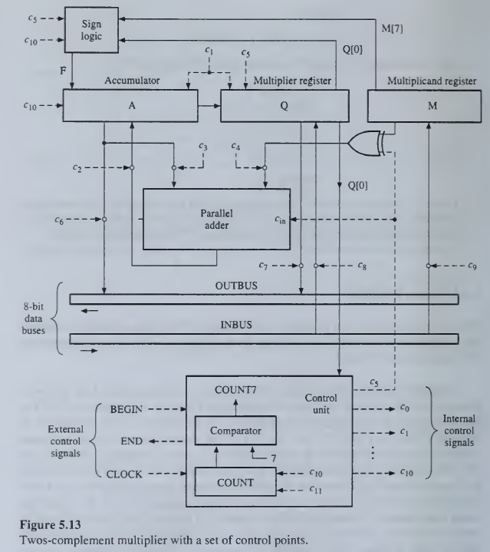
UNIT III – CONTROL UNIT DESIGN
2’s Complement Multiplier:
2’s Complement Multiplier with Control Signals

Slide 24
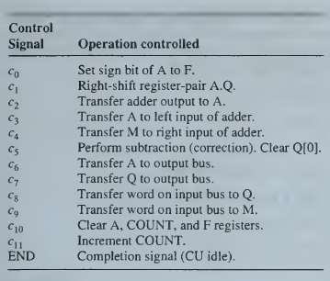
UNIT III – CONTROL UNIT DESIGN
2’s Complement Multiplier:
Control Signals

Slide 25
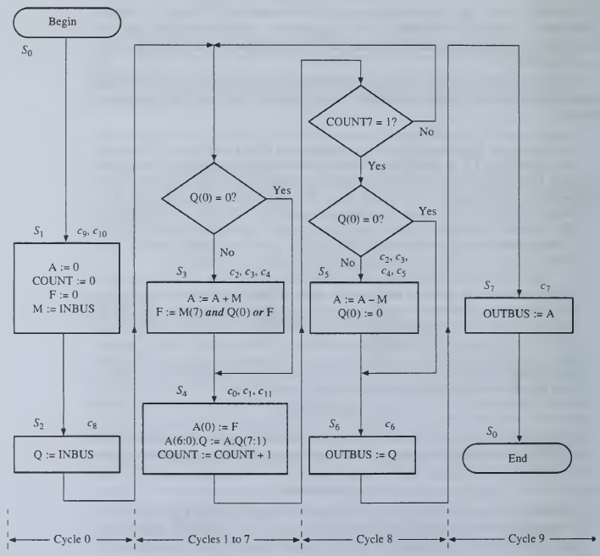
UNIT III – CONTROL UNIT DESIGN
2’s Complement Multiplier:
Flow Diagram for Multiplier

Slide 26
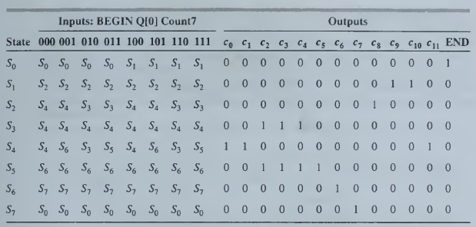
UNIT III – CONTROL UNIT DESIGN
2’s Complement Multiplier:
State Table for Multiplier
State | Inputs (Begin Q(0) Count7) |  |  |  |  |  |  |  | Outputs
 | 000 | 001 | 010 | 011 | 100 | 101 | 110 | 111 | C0 | C1 | C2 | C3 | C4 | C5 | C6 | C7 | C8 | C9 | C10 | C11 | END
S0 | S0 | S0 | S0 | S0 | S1 | S1 | S1 | S1 | 0 | 0 | 0 | 0 | 0 | 0 | 0 | 0 | 0 | 0 | 0 | 0 | 1
S1 | S2 | S2 | S2 | S2 | S2 | S2 | S2 | S2 | 0 | 0 | 0 | 0 | 0 | 0 | 0 | 0 | 0 | 1 | 1 | 0 | 0
S2 | S4 | S4 | S3 | S3 | S4 | S4 | S3 | S3 | 0 | 0 | 0 | 0 | 0 | 0 | 0 | 0 | 1 | 0 | 0 | 0 | 0
S3 | S4 | S4 | S4 | S4 | S4 | S4 | S4 | S4 | 0 | 0 | 1 | 1 | 1 | 0 | 0 | 0 | 0 | 0 | 0 | 0 | 0
S4 | S4 | S6 | S3 | S5 | S4 | S6 | S3 | S5 | 1 | 1 | 0 | 0 | 0 | 0 | 0 | 0 | 0 | 0 | 0 | 1 | 0
S5 | S6 | S6 | S6 | S6 | S6 | S6 | S6 | S6 | 0 | 0 | 1 | 1 | 1 | 1 | 0 | 0 | 0 | 0 | 0 | 0 | 0
S6 | S7 | S7 | S7 | S7 | S7 | S7 | S7 | S7 | 0 | 0 | 0 | 0 | 0 | 0 | 1 | 0 | 0 | 0 | 0 | 0 | 0
S7 | S0 | S0 | S0 | S0 | S0 | S0 | S0 | S0 | 0 | 0 | 0 | 0 | 0 | 0 | 0 | 1 | 0 | 0 | 0 | 0 | 0

Slide 27
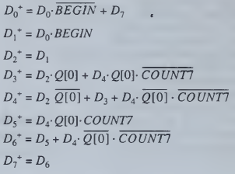
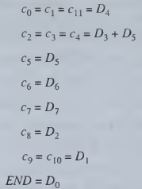
UNIT III – CONTROL UNIT DESIGN
2’s Complement Multiplier:
State Boolean Equations
ONE HOT METHOD:
D₀⁺ = D₀ (BEGIN)’ + D₇
D₁⁺ = D₀ (BEGIN)
D₂⁺ = D₁
D₃⁺ = D₁ Q(0) + D₄ Q(0) (COUNT7)’
D₄⁺ = D₂.Q(0)’ + D₃ + D₄ Q(0)’ (COUNT7)’
D₅⁺ = D₄ Q(0) (COUNT7)

Slide 28
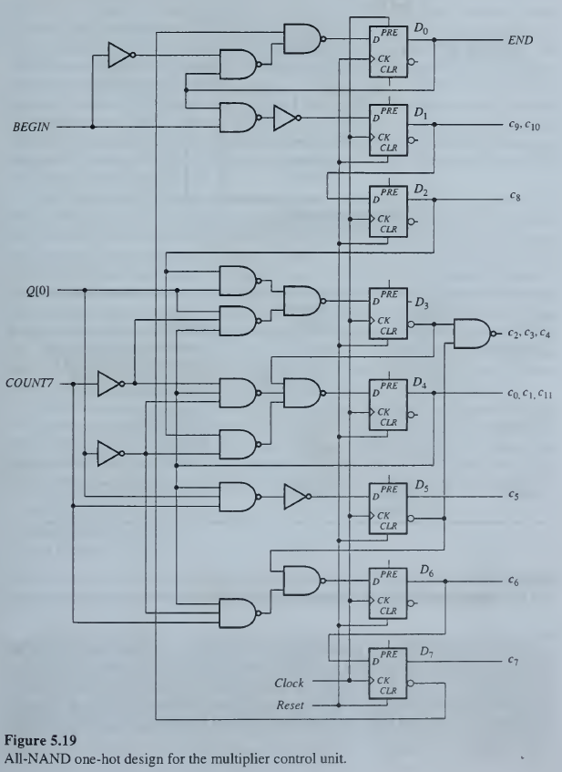
UNIT III – CONTROL UNIT DESIGN
2’s Complement Multiplier:
One-Hot Realization using NAND Gates

Slide 29
UNIT III – CONTROL UNIT DESIGN
CPU Control Unit
CPU Flowchart Description
All instructions require a common instruction-fetch step, followed by an execution step that varies with each instruction type.
The fetch step copies the contents of the program counter PC to the memory address register AR.
A memory-read operation is then executed, which transfers the instruction word / to memory data register DR; this is expressed by DR := M(AR).
I's opcode is transferred to the instruction register IR, where it is decoded; at the same time PC is incremented to point to the next consecutive instruction in M.
The subsequent operations depend on the opcode pattern.
For example, the store instruction ST X is executed in three steps: the address field of ST X is transferred to AR, the contents of the accumulator AC are transferred to DR.
Finally the memory write operation M(AR) := DR is performed.

Slide 30
UNIT III – CONTROL UNIT DESIGN
CPU Control Unit
CPU Flowchart Description
The branch-on-zero instruction BZ adr is executed by first testing AC.
If AC ≠ 0, no action is taken.
If AC = 0, the address field adr, which is in DR(ADR), is transferred to PC, thus effecting the branch operation.
The micro-operations appearing in the flowchart implicitly determine the control signals and control points needed by the CPU.
These control lines can be placed in the three basic groups.
Function select: c₂ , c₉, c₁₀, c₁₁ , c₁₂ .
Storage control: c₁, c₈ .
Data routing: c₀, c₃ , c₄, c₄ , c₆, c₇.

Slide 31
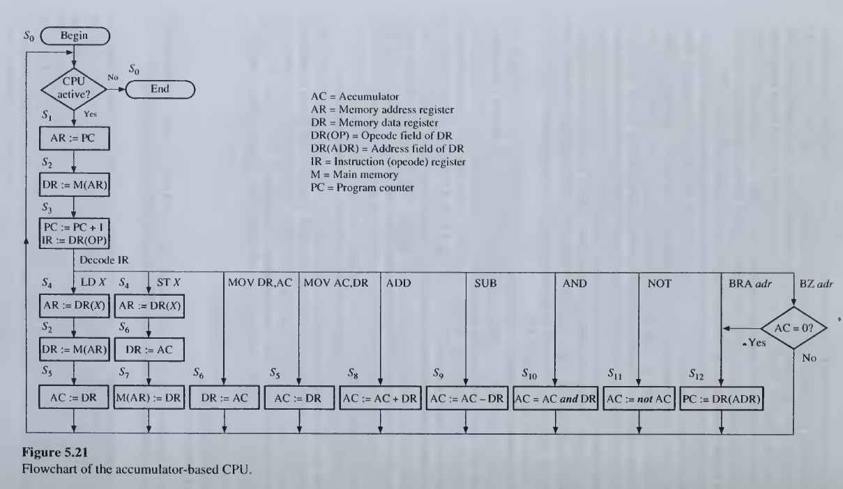
UNIT III – CONTROL UNIT DESIGN
CPU Control Unit
CPU Flowchart

Slide 32
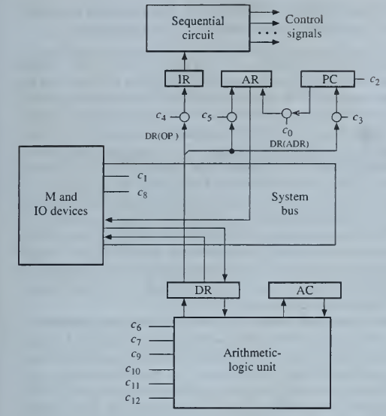
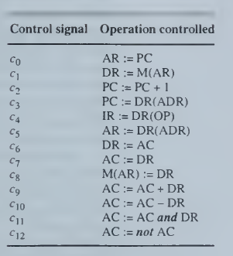
UNIT III – CONTROL UNIT DESIGN
CPU Control Unit
CPU Flowchart

Slide 33
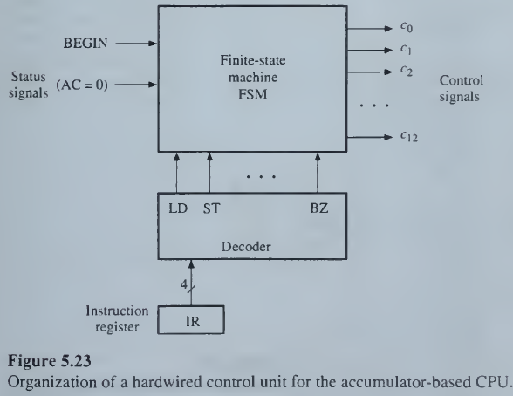
UNIT III – CONTROL UNIT DESIGN
CPU Control Unit
CPU Hardwire Unit

Slide 34
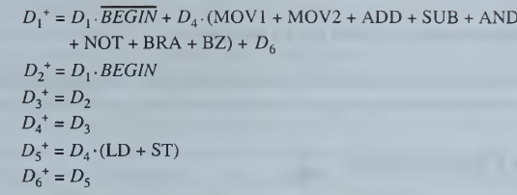
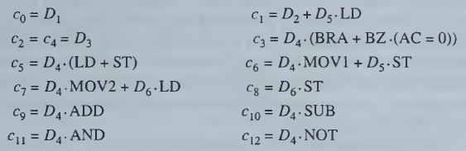
UNIT III – CONTROL UNIT DESIGN
CPU Control Unit
CPU Hardwire Unit

Slide 35
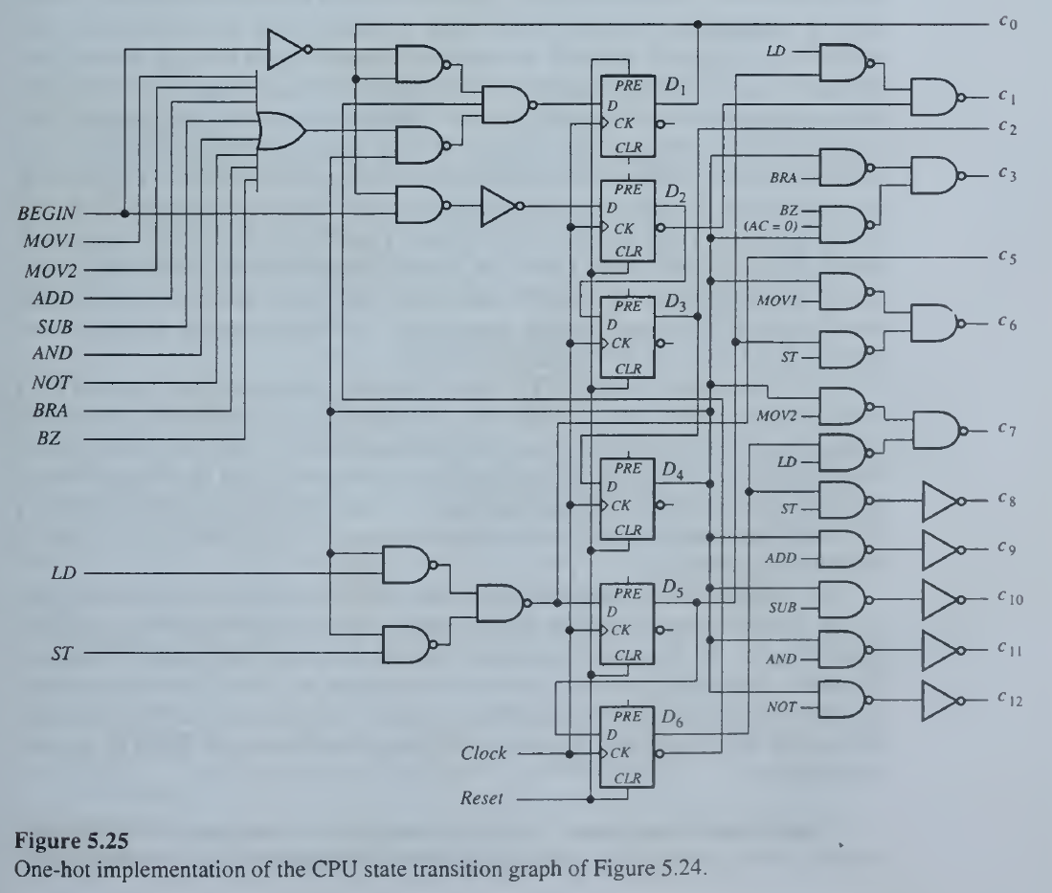
UNIT III – CONTROL UNIT DESIGN
CPU Control Unit
CPU One-Hot Hardwire Unit

Slide 36
UNIT III – CONTROL UNIT DESIGN
Microprogrammed Control Unit
Basic Concepts
An instruction is implemented by a sequence of one or more sets of concurrent microoperations.
Each microoperation is associated with a group of control lines that must be activated in a prescribed sequence to trigger the microoperations.
Disadvantage: Hardwired control unit
As the number of instructions and control lines can be in the hundreds, a hardwired control unit is difficult to design and verify.
Hardwired control unit is inherently inflexible in the sense that changes, for example, to correct design errors or update the instruction set, require that the control unit be redesigned.
Solution:
Flexible, easy design Microprogrammed Control Unit

Slide 37
UNIT III – CONTROL UNIT DESIGN
Microprogrammed Control Unit
Basic Concepts
Control Memory: Microprogramming is a method of control-unit design in which the control signal selection and sequencing information is stored in a ROM or RAM called a control memory CM.
Microinstruction: The control signals to be activated at any time are specified by a microinstruction, which is fetched from CM in much the same way an instruction is fetched from main memory.
Each microinstruction also explicitly or implicitly specifies the next microinstruction to be used, thereby providing the necessary information for microoperation sequencing.
Microprogram: A set of related microinstructions forms a microprogram.
Microprogram Advantage and Disadvantages:
Microprograms can be changed relatively easily by changing the contents of CM; hence microprogramming yields control units that are more flexible than their hardwired counterparts.
This flexibility is achieved at some extra hardware cost due to the control memory and its access circuitry.
There is also a performance penalty due to the time required to access the microinstructions from CM.
These disadvantages have discouraged the use of microprogramming in RISCs and other high-speed processors, where chip area and circuit delay must both be minimized.
Adaptability to various processors also expected.

Slide 38
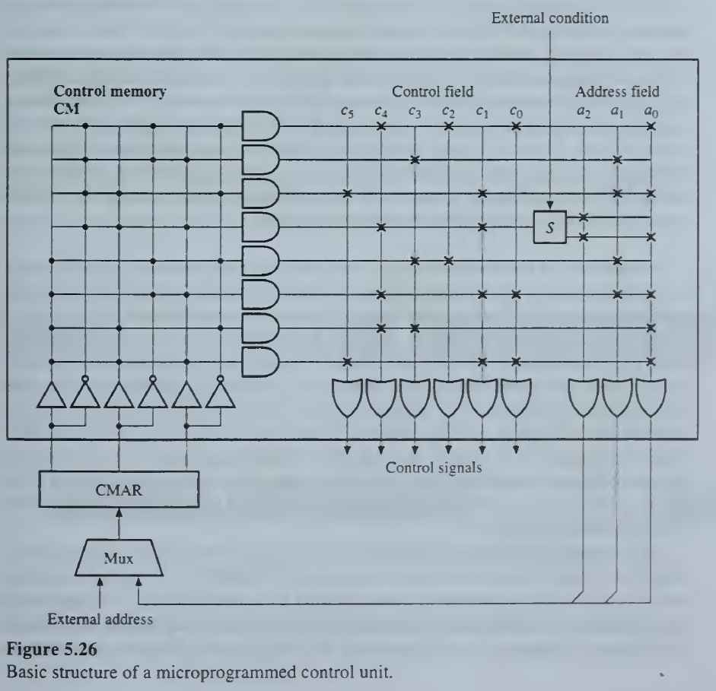
UNIT III – CONTROL UNIT DESIGN
Microprogrammed Control Unit
Control Unit Organization

Slide 39
UNIT III – CONTROL UNIT DESIGN
Microprogrammed Control Unit
Control Unit Organization
A microinstruction has two parts: a set of control fields that specify the control signals to be activated and an address field that contains the address in CM of the next microinstruction to be executed.
Each bit k_{i} of a control field corresponds to a distinct control line c_{i}.
When k_{i} = 1 in the current microinstruction, c, is activated: otherwise c_{i} remains inactive.
The control memory CM is implemented by a ROM.
The left part (AND plane) of the ROM decodes an address obtained from the control memory address register (CMAR).
Each address selects a particular row in the right part (OR plane) of the ROM that contains a microinstruction composed (in this small example) of a 6-bit control field and a 3- bit address field.
When the top-most row represents the microinstruction with address 000, is selected, the control signals c₀, c₂, and c₄ are activated, as indicated by the ‘✖’s in the control field.
At the same time, the contents of the address field a₂a₁a₀ = 001 are sent to the CMAR, where they are stored and used to address the next microinstruction to be executed.

Slide 40
UNIT III – CONTROL UNIT DESIGN
Microprogrammed Control Unit
Control Unit Organization
The CMAR can be loaded from an external source as well as from the address field of a microinstruction.
The external source typically provides the starting address of a microprogram in the CM.
A specific microprogram prestored in CM executes (interprets) each instruction of a microprogrammed CPU. The instruction's opcode, after suitable 'encoding, provides the starting address for its microprogram.
Every program control unit should be able to respond to external signals or conditions.
We can satisfy this requirement by introducing some form of switch S controlled by an external condition that allows the current microinstruction to select one of two possible address fields.
Thus in Figure 5.26, the third microinstruction may be followed by the microinstruction with address 100 or 101, as determined by the external condition.
This feature makes conditional branches within a microprogram possible.

Slide 41
UNIT III – CONTROL UNIT DESIGN
Microprogrammed Control Unit
Control Unit Organization
Microinstruction length is determined by three factors:
The maximum number of simultaneous microoperations that must be specified, that is, the degree of parallelism required at the microoperation level.
The way in which the control information is represented or encoded.
The way in which the next microinstruction address is specified.
Writable control memory or Dynamically microprogrammable
The control memory contents can be altered under program control.

Slide 42
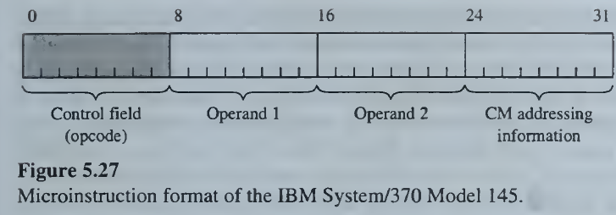
UNIT III – CONTROL UNIT DESIGN
Microprogrammed Control Unit
Parallelism in microinstructions
Due to lack of parallelism, more microinstructions are needed to perform a given operation.
The format of the IBM System/370 Model 145, is representative of this type of microinstruction.
It consists of 4 bytes (32 bits).
The leftmost byte (shaded) is an opcode that specifies the microoperation to be performed.
The next 2 bytes specify operands, which, in most cases, are the addresses of CPU registers.
The right-most byte contains information used to construct the address of the next microinstruction.

Slide 43
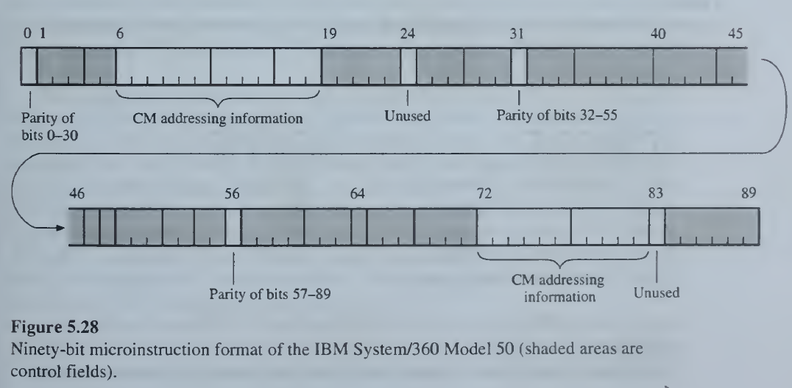
UNIT III – CONTROL UNIT DESIGN
Microprogrammed Control Unit
Parallelism in microinstructions
Microinstruction formats take advantage of the fact that, at the microprogramming level, many operations can be performed in parallel.
If all useful combinations of parallel microoperations were specified by a single opcode.
Each control field handles a limited set of microoperations, any one of which can be performed simultaneously with the microoperations specified by the remaining control fields.
A control field often specifies the control-line values for a single device such as an adder, a register, or a bus.
It encompasses 90 bits, which are partitioned into separate fields for various purposes.
There are 21 fields, which constitute the control fields.
The remaining fields are used to generate the next microinstruction address and to detect errors by means of parity bits.

Slide 44
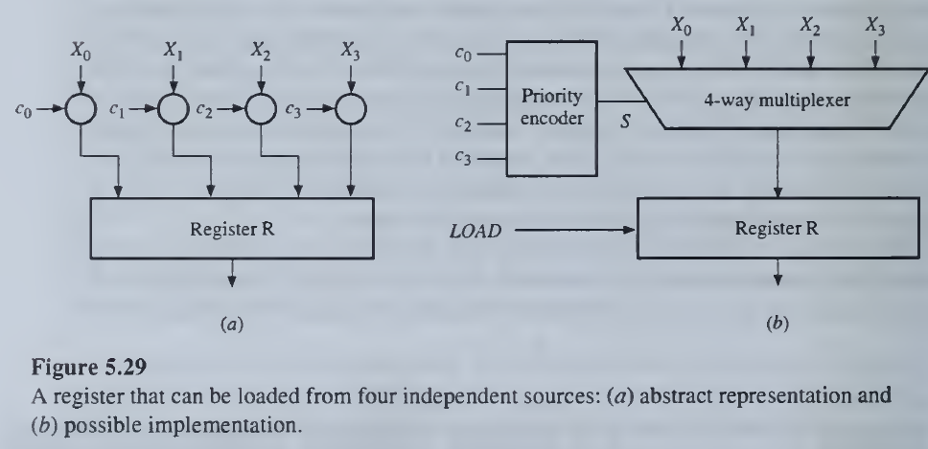
UNIT III – CONTROL UNIT DESIGN
Microprogrammed Control Unit
Parallelism in microinstructions

Slide 45
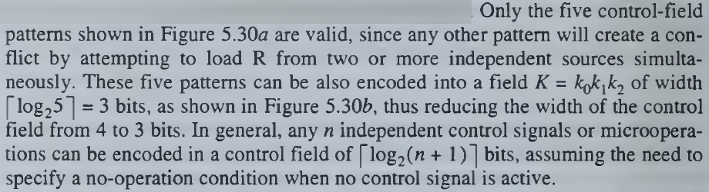
UNIT III – CONTROL UNIT DESIGN
Microprogrammed Control Unit
Parallelism in microinstructions
Consider, for instance, the register R, which can be loaded from any of four independent sources under the control of the four separate signals c0,c1,c2,c3.
The implementation of the associated control points using an encoder and a Multiplexer.
Suppose that the c_{i}'s are derived from a microinstruction control field in which there is 1-bit for each control signal.
This results in the 4-bit control field.

Slide 46
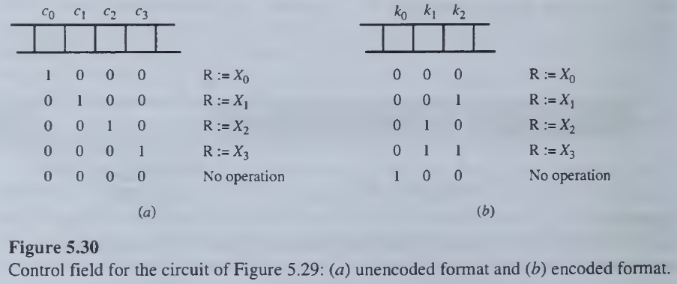
UNIT III – CONTROL UNIT DESIGN
Microprogrammed Control Unit
Parallelism in microinstructions
The unencoded format of Figure 5.30a has the advantage that all the control signals are individually identified in, and can be obtained directly from, the microinstruction.
The encoded control signals k0, k1, k2 of Figure 5.30b must be passed through a decoder if we wish to extract the four original control signals c0, c1,c2,c3.

Slide 47
UNIT III – CONTROL UNIT DESIGN
Microprogrammed Control Unit
Horizontal Vs Vertical
Microinstructions are commonly divided into two types.
Horizontal Microinstructions:
Long formats.
Ability to express a high degree of parallelism.
Little encoding of the control information.
Vertical Microinstructions:
Short formats.
Limited ability to express parallel micro-operations.
Considerable encoding of the control information.

Slide 48
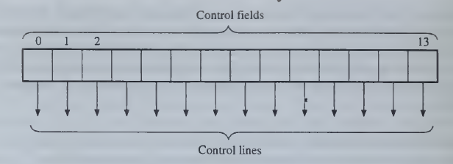
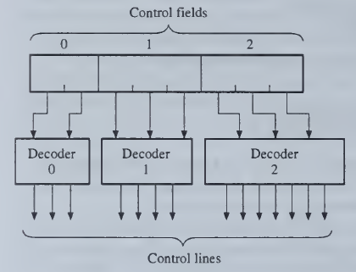
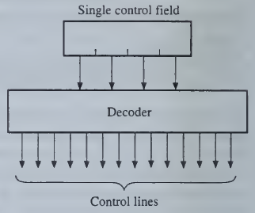
UNIT III – CONTROL UNIT DESIGN
Microprogrammed Control Unit
Horizontal Vs Vertical (Control Field Formats)
No encoding
Some encoding
Complete encoding

Slide 49
UNIT III – CONTROL UNIT DESIGN
Microprogrammed Control Unit
Micro Instruction Addressing
Each microinstruction in the basic design of Figure 5.26 contains within itself the address of the next microinstruction to be executed.
In the case of branch microinstructions, two possible next addresses are included.
This explicit address specification has the advantage that no time is lost in microinstruction address generation, but it is wasteful of control memory space.
The address fields can be eliminated from all but branch instructions by using a microprogram counter μPC as the primary source of microinstruction addresses.
Its role is analogous to that of the program counter PC at the instruction level. Since only instructions have to be fetched from the control memory, |μPC is also used as the control memory address register CMAR.

Slide 50
UNIT III – CONTROL UNIT DESIGN
Microprogrammed Control Unit
Micro Operation Timing
Monophase:
A single clock signal synchronizes the control signals, and its period can be the same as the microinstruction cycle period.
This mode of control has been termed monophase.
Polyphase:
This polyphase mode of operation permits a single microinstruction to specify a short sequence of microoperations for some increase in the complexity of the microinstruction format.

Slide 51
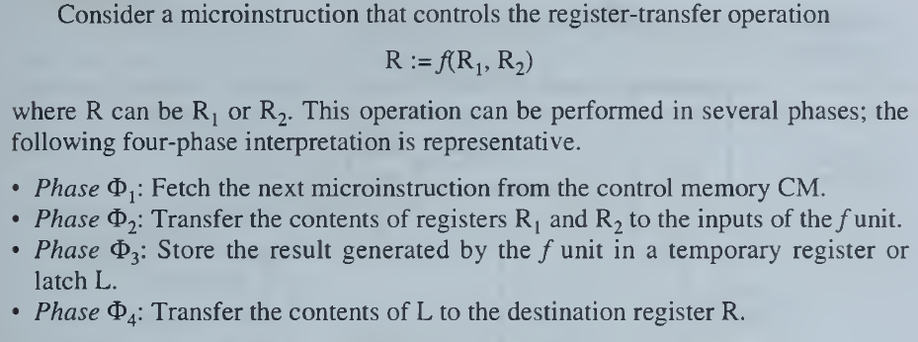
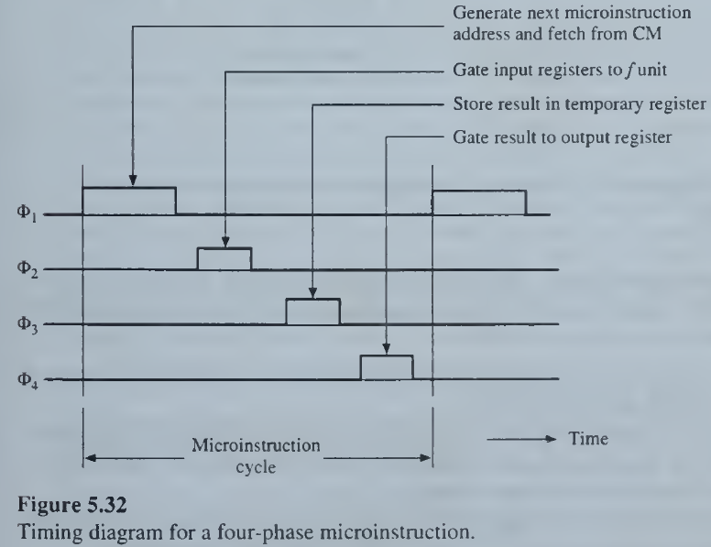
UNIT III – CONTROL UNIT DESIGN
Microprogrammed Control Unit
Micro Operation Timing

Slide 52
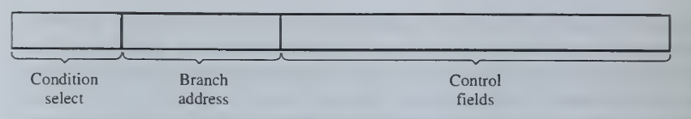
UNIT III – CONTROL UNIT DESIGN
Microprogrammed Control Unit
Control Unit Organization
Microinstruction format has three parts arranged as follows:
A condition-select field specifies the external condition to be tested in the case of conditional branch microinstructions.
An address field contains the next-address field to be used when a branch condition is satisfied. A microprogram counter (μPC provides the next microinstruction address when no branching is needed.
Control field: The rest of the microinstruction specifies in encoded or unencoded format the control signals that are activated to perform the desired microoperations.

Slide 53
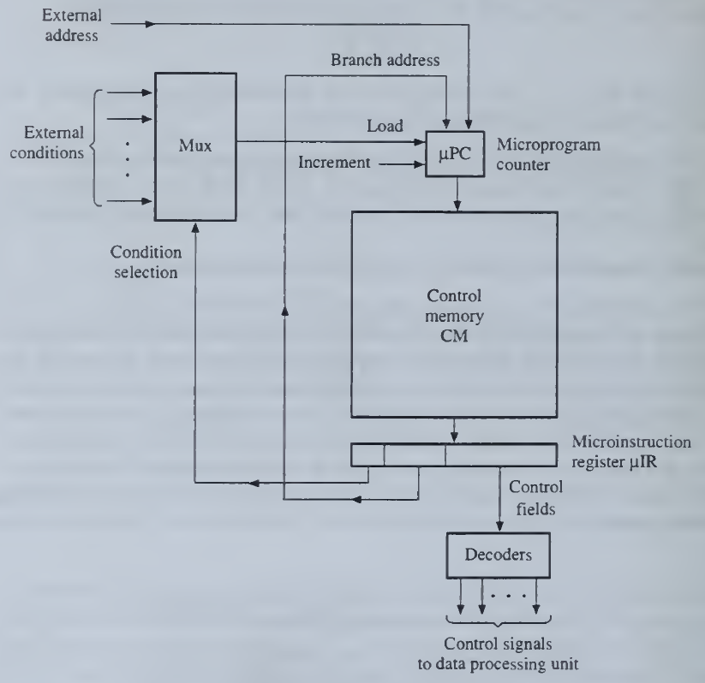
UNIT III – CONTROL UNIT DESIGN
Microprogrammed Control Unit
Control Unit Organization

Slide 54
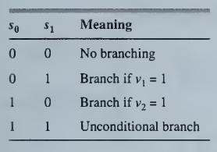
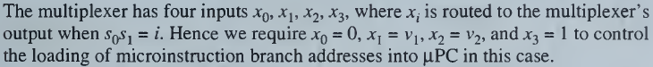
UNIT III – CONTROL UNIT DESIGN
Microprogrammed Control Unit
Control Unit Organization
The counter μPC is the address register for the control memory CM. The contents of the addressed word in CM are transferred to the microinstruction register μIR.
The control fields are decoded if necessary and produce control signals for the data-processing unit; μPC is then incremented. If a branch is specified by the microinstruction in μIR, the contents of the microinstruction's address field are loaded into μPC.
The condition-select field controls a multiplexer that activates the parallel-load control input of μPC based on the status of some external condition variables.
Suppose that two condition variables v₁,v₂ must be tested. A condition-select field s₀, s₁ of 2-bits suffices, with the following interpretation:
Finally, a provision is made for loading μPC with an address from an external source.
This address is used to enter the starting address of the desired microprogram in cases where CM contains more than one microprogram.

Slide 55
UNIT III – CONTROL UNIT DESIGN
Multiplier Microprogrammed Control Unit

Slide 56
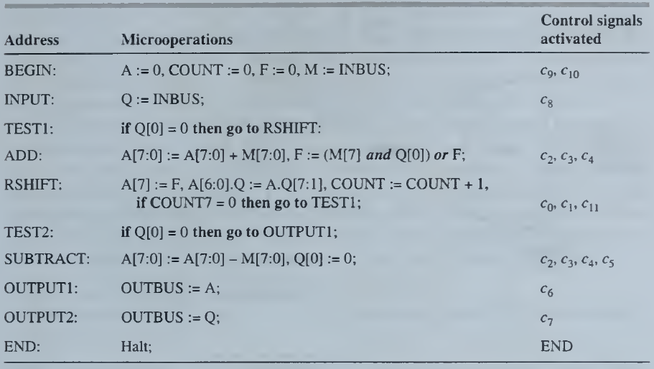
UNIT III – CONTROL UNIT DESIGN
Multiplier Microprogrammed Control Unit

Slide 57
UNIT III – CONTROL UNIT DESIGN
Multiplier Microprogrammed Control Unit
Three parts: a condition-select field, a branch address, and a set of control fields.
An address field of 4 bits can address up to 16 microinstructions.
Initially, no encoding of control signals will be done, so that there are thirteen 1-bit control fields, one for each of the control lines c0, c1…. . .,c11 ,END.
During each microinstruction cycle, μPC is incremented to produce the address of the next microinstruction.
The condition-select field has to indicate one of four conditions:
No branching
Branch if Q[0] = 0
Branch if COUNT7 = 0
Unconditional branch
Hence a 2-bit condition-select field is needed.
We conclude that a 19-bit microinstruction word is sufficient when a full horizontal version of the format

Slide 58
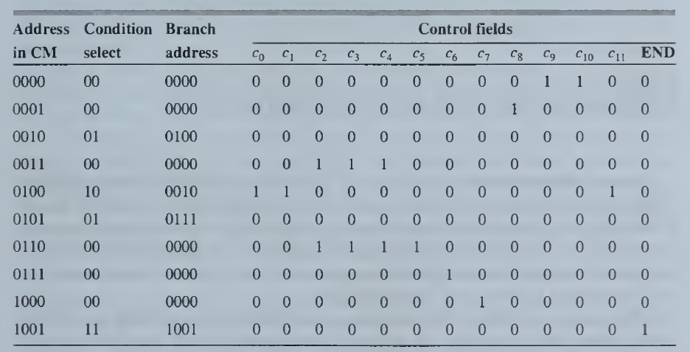
UNIT III – CONTROL UNIT DESIGN
Multiplier Microprogrammed Control Unit
Consecutive microinstructions are assigned to consecutive addresses, and the appropriate condition-select bits are inserted (00 denotes no branching; the remaining condition codes are easily deduced).
When multiplication is completed, the micro-program enters a waiting (halt) state by repeatedly executing the no-operation microinstruction in CM location1001.
It remains in this state until μPC is reset by the arrival of an external BEGIN signal.

Slide 59
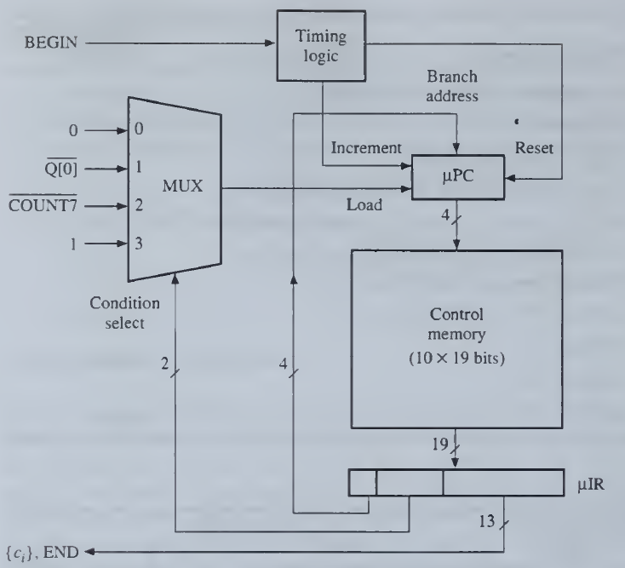
UNIT III – CONTROL UNIT DESIGN
Multiplier Microprogrammed Control Unit
Microprogrammed control unit

Slide 60
UNIT III – CONTROL UNIT DESIGN
Multiplier Microprogrammed Control Unit
Control Field Encoding
Removing Redundant Fields
Encoding by Compatible Class
Encoding By Function
Multiple Micro-Instructions Format

Slide 61
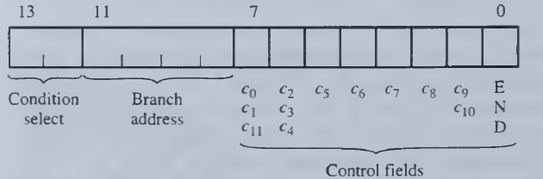
UNIT III – CONTROL UNIT DESIGN
Multiplier Microprogrammed Control Unit
Control Field Encoding
Removing Redundant Fields
Several sets of control signals are always activated simultaneously; hence a single 1-bit control field suffices for each such set.
The 8 bits reserved for the 3 sets {c0 ,c1, c11}, {c2, c3, c4}, and {c9, c10} can be replaced by 3 bits, yielding the short, horizontal format

Slide 62
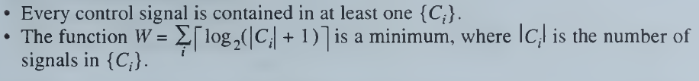
UNIT III – CONTROL UNIT DESIGN
Multiplier Microprogrammed Control Unit
Control Field Encoding
Encoding by Compatible Class
A systematic method of encoding is to divide the control signals into sets that are compatible in the sense that no two members of set, called a compatibility class, are ever active at the same time.
A collection of compatibility classes {Ci} of control signals such that;
There are only two incompatible microoperations, namely c2 and c5 , which are activated together in the SUBTRACT microinstruction.
There are several ways to choose subsets of C₀ and C₁ that cover all control signals.
C‘₀ = {c0, c2, c6 } and C’₁ = {c5, c7, c8, c9, END}.

Slide 63
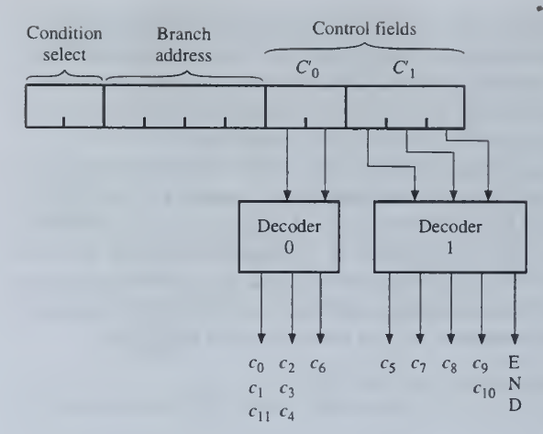
UNIT III – CONTROL UNIT DESIGN
Multiplier Microprogrammed Control Unit
Control Field Encoding
Encoding by Compatible Class

Slide 64
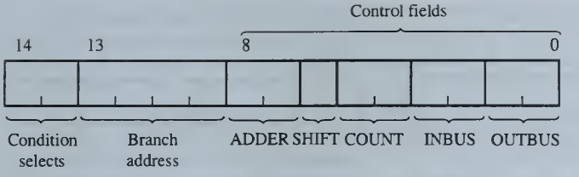
UNIT III – CONTROL UNIT DESIGN
Multiplier Microprogrammed Control Unit
Control Field Encoding
Encoding By Function
In the previous method, functionally unrelated control signals are combined in the same control field, while related signals are derived from different control fields.
An encoded format in which each control field specifies the control signals for one component or for a related set of operations is preferred,
There are five components to be controlled: the adder, the A.Q register-pair, the external iteration counter COUNT, and the two data buses INBUS and OUTBUS.

Slide 65

UNIT III – CONTROL UNIT DESIGN
Multiplier Microprogrammed Control Unit
Control Field Encoding
Encoding By Function

Slide 66
UNIT III – CONTROL UNIT DESIGN
Multiplier Microprogrammed Control Unit
Control Field Encoding
Multiple Micro-Instructions Format
In the original multiplication microprogram, several microinstructions are used only for next-address generation and do not activate any control lines.
This suggests that we can reduce microinstruction size by using a single field to contain either control information or address information.
We then obtain two distinct microinstruction types:
Branch microinstructions - which specify no control information
Action or operate microinstructions - which activate control lines but have no branching capability.
Now we define a microinstruction format having two parts, a 2-bit condition-select field with the same meaning as before, and an 8-bit field that can contain either a branch address or control information.

Slide 67



UNIT III – CONTROL UNIT DESIGN
Multiplier Microprogrammed Control Unit
Control Field Encoding
Multiple Micro-Instructions Format

Slide 68
UNIT III – CONTROL UNIT DESIGN
CPU Microprogrammed Control Unit

Slide 69

UNIT III – CONTROL UNIT DESIGN
CPU Microprogrammed Control Unit

Slide 70


UNIT III – CONTROL UNIT DESIGN
CPU Microprogrammed Control Unit

Slide 71

UNIT III – CONTROL UNIT DESIGN
CPU Microprogrammed Control Unit

Slide 72

UNIT III – CONTROL UNIT DESIGN
Nano Programming
In a few machines, however, the microinstructions do not directly issue the signals that control the hardware.
Instead, they are used to access a second control memory called a nanocontrol memory nCM that directly controls the hardware.
In such cases there are two levels of control memories, a higher-level one termed a microcontrol memory μCM whose contents are microinstructions and the lower-level nCM that stores nanoinstructions

Slide 73


UNIT III – CONTROL UNIT DESIGN
Nano Programming
The advantage of this two-level control design technique is that it can reduce the total size S2 = Hm x Wm + Hn xWn of the control memories,
S1=Hm x Wm
S2 = Hm x Wm + Hn xWn
Two level
One level

Slide 74



UNIT III – CONTROL UNIT DESIGN
Nano Programming
A one level conventional CM is assumed to store Hm horizontal microinstructions each with a format consisting of N control bits and next-address bits.
The size of One Level memory is
The size of Two Level memory is
We can write Hn = rHm ,
where r is the ratio of the number of unique control states to the total number Hn of control states needed to implement all instructions.

Slide 75
UNIT III – CONTROL UNIT DESIGN
Nano Programming – Example Problem:
The following parameters are cited for the 68000 design: N = 70, Hm = 650, and r = 0.4 so that Hn = 260. Then find S1 and S2.
S1 = 52,450 and
S2 = 30,550.
Consequently, the use of nanoprogramming saves a total of 52,450 - 30,550 = 21,850 bits of control storage (42 percent of S1).

Slide 76

UNIT III – CONTROL UNIT DESIGN
Pipeline Control:

Slide 77

UNIT III – CONTROL UNIT DESIGN
Pipeline Control:

Slide 78

UNIT III – CONTROL UNIT DESIGN
Pipeline Control:
IF: instruction fetching and decoding using the I-cache.
OL: operand loading from the D-cache to RF.
EX: data processing using the ALU and RF.
OS: operand storing to the D-cache from RF.

Slide 79



UNIT III – CONTROL UNIT DESIGN
Pipeline Control:
(a) R2/3000 pipeline delay slot caused by load instruction LD;
(b) use of NOP instruction to fill the delay slot
(c) use of SUB instruction to eliminate the delay slot.

Slide 80
UNIT III – CONTROL UNIT DESIGN
Pipeline Performance:
Performance measures
A pipeline's performance can be measured by its throughput in terms of millions of instructions executed per second or MIPS.
Another popular measure of performance is the number of clock cycles per instruction or CPI.
CPI=f/MIPS
Where f is the pipeline's clock frequency in MHz.
A useful way to visualize pipeline behavior called a space-time diagram, which shows the utilization of each pipeline stage as a function of time.
In general, a space-time diagram for an /n-stage pipeline has the form of an m x n grid, where n is the number of clock cycles to complete the processing of some sequence of N instructions of interest.

Slide 81

UNIT III – CONTROL UNIT DESIGN
Pipeline Performance:
Performance measures
The stages are also underutilized if operands are not available when needed.
The ratio of the unshaded (busy) area to the total (shaded and unshaded) area of a space-time diagram for an m-stage pipeline is defined as the efficiency or utilization E{m) of the pipeline.
In other words, E(m) is the fraction of time the pipeline is busy.
The efficiency is E(4) = 44/76 = 0.58.
Another general measure of pipeline performance is the speedup S(m) defined by
S(m) = T(1)/T{m)
where T(m) is the execution time for some target workload on an m-stage pipeline and T(1) is the execution time for the same workload on a similar, nonpipelined processor.

Slide 82
UNIT III – CONTROL UNIT DESIGN
Pipeline Performance:
Performance measures
It is reasonable to assume that T(1) <mT(m), in which case S(m) ≤ m.
A pipeline's efficiency and speedup are related as follows:
S(m) = m x E(m)
Hence for the example in Figure 5.60 where m = 4 and E(4) = 0.58,
the speedup 5(4) = 4 x 0.58 = 2.32 and cannot exceed 4.

Slide 83


UNIT III – CONTROL UNIT DESIGN
Pipeline Performance:
Optimizing ‘m’
An easy way to improve a pipeline‘s performance is to increase the number of stages m.
Each new stage S, introduces some new hardware cost and delay due to its buffer register Ri and associated control logic.
Pipeline's performance/cost ratio PCR
Where f is the pipeline's clock frequency and K is its hardware cost.
The pipeline P has m stages and implements a particular set of operations (instructions).
Let a be the delay (latency) of an efficient, nonpipelined processor that also implements SI.
It is reasonable to assume that each stage Si, of P has delay a/m—that is, m times less than the corresponding nonpipelined processor plus some extra delay b due to Si buffer register Ri.

Slide 84



UNIT III – CONTROL UNIT DESIGN
Pipeline Performance:
Optimizing ‘m’
where c is the buffer-register cost per stage and d is the cost of the pipeline's data-processing logic.
Hence,
To maximize PCR with respect to the number of stages m, we differentiate (5.28) with respect to m and equate the result to zero. Using the standard differentiation by parts formula

Slide 85



UNIT III – CONTROL UNIT DESIGN
Pipeline Performance:
Optimizing ‘m’
On equating to zero, we get
Substituting for ‘v’ and solving for m yields the value m_{opt} of m that maximizes PCR,

Slide 86

UNIT III – CONTROL UNIT DESIGN
Pipeline Performance:
Optimizing ‘m’
PCR against m for a = d = 5 and b = c = 1.
The optimum value of m is five
Performance/cost ratio PCR for an m-stage pipeline.

Slide 87

UNIT III – CONTROL UNIT DESIGN
Collisions:
When more than one instructions are trying to access the same stage/resources Collisions occurs.
pipeline collisions of the foregoing type are avoided by carefully scheduling the times at which new pipeline operations are initiated
Let
P denotes Pipeline Process
m denotes Stages (s₁, s₂, …. s_{m})
R denotes Reservation Table
F denotes Forbidden List
L denotes Initiation Latency

Slide 88
UNIT III – CONTROL UNIT DESIGN
Collisions:
Reservation Table (R):
The Stages filled with operations/instructions at the instant t (clock)
Forbidden List (F):
The number of clock cycles in Horizontal distance of a row between × marked in R.
{1, 4, 5} during this distance, no new instructions to be released.
Initiation Latency (L):
The delay occurring between the start of two successive, collision-free pipeline instructions.
It corresponds to the pipeline's CPI and is measured in clock cycles.
L_{min} - the minimum value of the initiation latency
L_{cmin} – the minimum constant latency (any number of instructions can be initiated L clock cycles apart without causing collisions)

Slide 89
UNIT III – CONTROL UNIT DESIGN
Collisions Control Scheme:
An elegant way to control a pipeline for collision-free operation is by computing collision vectors.
CV - Collision Vector {C₁, C₂, …C_{M}}
when Ci = 1 then releasing a new instruction at ti+1 results in a Collision
when Ci = 0 then new instruction at ti+1 can be released
CV₀ – Initial Collision Vector {C₁, C₂, …C_{M}} from Forbidden list
Ci = 1 if ‘i’ is in Forbidden list
Ci = 0 otherwise
CR = {CR₁:CR_{M}} – Collision Register
By inspecting CR, at time t, we can determine whether issuing a new instruction in the next clock cycle t + 1 will result in a collision

Slide 90
UNIT III – CONTROL UNIT DESIGN
Collisions Control Scheme:
Algorithm:
Initialize CV₀ with F,
CR = 00000 at t = 0
CR = CR or CV₀
CR ={CR₁:CR_{M}};
CR₁ = 0; new instructions being issued at t = t+1.
Shift CR Left one bit and do CR or CV₀ (update)
else if CR₁ = 1 then, no new instruction at t = t+1.
and do Left shit of CR.
or denotes the bitwise OR operation

Slide 91
UNIT III – CONTROL UNIT DESIGN
Collisions Control Scheme:
Example:
F = {1, 4, 5}
m = 5
CV₀ = {10011}

Slide 92
UNIT III – CONTROL UNIT DESIGN
Collisions Control Scheme:
t = 0 CR = 00000
CR₁ = 0; New instruction at t=1;
Left Shift CR = 00000
Update CR = CR or CV₀ = 10011
t = 1 CR = 10011
CR₁ = 1; No New instruction at t=2
Left Shift CR = 00110
t = 2 CR = 00110
CR₁ = 0; New instruction at t=3;
Left Shift CR = 01100
Update CR = CR or CV₀ = 11111
t = 3 CR = 11111
CR₁ = 1; No New instruction at t=4
Left Shift CR = 11110
t = 4 CR = 11100
t = 5 CR = 11000
t = 6 CR = 10000
t = 7 CR = 00000
t = 8 CR₁ = 0; New instruction at t=9;
Left Shift CR = 00000
Update CR = CR or CV₀ = 10011
Cycle repeats hereafter.
Example:
F = {1, 4, 5}
m = 5
CV₀ = {10011}
Case: I

Slide 93
UNIT III – CONTROL UNIT DESIGN
Collisions Control Scheme:
t = 0 CR = 00000
CR₁ = 0; New instruction at t=1;
Left Shift CR = 00000
Update CR = CR or CV₀ = 10011
t = 1 CR = 10011
CR₁ = 1; No New instruction at t=2
Left Shift CR = 00110
t = 2 CR = 00110
CR₁ = 0; New instruction at t=3;
Left Shift CR = 01100
t = 3 CR = 01100
CR₁ = 0; New instruction at t=4
Left Shift CR = 11000
Update CR = CR or CV₀ = 11011
t = 4 CR = 10110
t = 5 CR = 01100
t = 6 CR = 01100; New instruction at t=7
Left Shift CR = 11000
Update CR = CR or CV₀ = 11011
Cycle repeats hereafter.
Example:
F = {1, 4, 5}
m = 5
CV₀ = {10011}
Case: II
If no new Instruction is released at t=3, then

Slide 94

UNIT III – CONTROL UNIT DESIGN
Collisions Control Scheme:
Pipeline scheduling strategies for the reservation table : (a) nonoptimal and (b) optimal.

Slide 95
UNIT III – CONTROL UNIT DESIGN
Task Initiation Diagram:
6
CV₀ = 10011
3
6
2
6
CV₁ = 11011
CV₂ = 11111
3
A State transition graph for collision free schedule for initiating pipeline operation. For that a condensed state-transition graph for CR called Task Initiation Diagram (TID) is constructed.
Average Latency (L_{min}):
CV₀:CV₂ = (2+6)/2 = 4
CV₀:CV₂ = (3+6)/2 = 4.5
CV₀:CV₀ = (6+6)/2 = 6
CV₁:CV₁ = (3+3)/2 = 3
CV₁ is having minimum constant Latency

Slide 96
UNIT III – CONTROL UNIT DESIGN
Control Dependencies:
Branching Conditions are,
Conditional and Unconditional Jumps
Subroutine Calls
Other program control instructions for branching
In these cases the address of the next instruction is not known with certainty until after the program-control instruction ‘I’ has been executed.
If these happen to be the wrong instructions, that is, ‘I’ causes a jump to a distant part of the program, then provision must be made to cancel the effects of the partially executed instructions.
This process is sometimes termed flushing the pipeline and clearly reduces its throughput.

Slide 97
UNIT III – CONTROL UNIT DESIGN
Control Dependencies:
Solution 1: Speculative Execution
Anticipate the outcome of the branch condition test, and enter the instruction at I's more likely target address into the pipeline immediately after ‘I’. This process is known as speculative execution.
Pipeline flushing is then needed only when the wrong guess has been made.
Example:
p – Probability of encountering Branch Instruction
q – Probability of executing Branch Instruction
r – length of instruction sequence streaming through pipeline
Total number of instructions causing Branching = pqr
Total number of instructions without Branching = (1-pq)r
Total number of clock cycles n_{c} = pqrm + (1-pq)r
Average CPI = n_{c}/r = pqm + (1-pq) = 1 + pq(m-1)
When q=0; CPI =1. (No Branch instructions)
If p=0.2; q=0.4 and m=5 then CPI=1.32

Slide 98
UNIT III – CONTROL UNIT DESIGN
Control Dependencies:
Solution 2: Delayed Branching
The Branch Instructions Execution is delayed until the completion of the current Instructions.
If I₁ has branching, I₂ is already fetched, then branching has to wait unit I₂ is being executed.

Slide 99
UNIT III – CONTROL UNIT DESIGN
Data Dependencies:
Read After Write (RAW) Hazard – True data dependency
Write After Read (WAR) Hazard – Anti data dependency
Write After Write (WAW) Hazard – Output data dependency
RAW Hazard
WAR Hazard
WAW Hazard
Add R₃, R₂, R₁
Sub R₄, R₃
Add R₃, R₂, R₁
Sub R₂, R₅
Add R₃, R₂, R₁
Sub R₂, R₃, R₁
Add R₃, R₂, R₅

Slide 100
UNIT III – CONTROL UNIT DESIGN
Superscalar Processing:
Superscalar Processing: Several number of Instructions are concurrently Fetched, Decoded, Executed and Stored in a Pipeline fashion.
A superscalar CPU has multiple execution units (E-units), each of which is usually pipelined, so that they constitute a set of independent instruction pipelines.
The CPU‘s program control unit PCU is designed to fetch and decode several instructions concurrently.
It can issue or dispatch up to k instructions simultaneously to the various E-units where k, the instruction-issue degree, can be six or more using current technology.
The need to process so many instructions simultaneously without performance-degrading conflicts greatly complicates the design of the PCU.
Speedup Factor: (consider for 5 cycles per instruction)
Sequential: CPI = 5; S(1) = 1/5
Pipeline: CPI = 1; S(1) = m
Superscalar: CPI = 1/k; S(1) = k × m

Slide 101



UNIT III – CONTROL UNIT DESIGN
Superscalar Processing:
Sequential
Pipeline
Superscalar

Slide 102
UNIT III – CONTROL UNIT DESIGN
Superscalar Processing:
Following factors to be considered,
Instruction type: For example, a floating-point add instruction has to be issued to a floating-point E-unit and not to an integer E-unit.
E-unit availability: An instruction can be issued to a pipelined E-unit only if no collisions will result, as determined by the pipeline's reservation table.
Data dependencies: To avoid conflicting use of registers, data-dependency constraints among the operands of the active instructions must be satisfied.
Control dependencies: To maintain high performance levels, techniques are needed to reduce the impact of branch instructions on pipeline efficiency.
Program order: Instructions must eventually produce results in the order specified by the program being executed. The results may, however, be computed out of-order internally to improve the CPU's performance.

Slide 103
UNIT III – CONTROL UNIT DESIGN
Superscalar Processing:
Dynamic Instruction Scheduling
Tomasulo's algorithm,
Tomasulo's approach provides each shared E-unit F, with a set of reservation stations whose purpose is to receive instructions that use Fi, keep track of these instructions operands, and when all the operand values needed by a waiting instruction Ij become available, initiate execution of Ij by Fi
A reservation station can thus be seen as implementing a virtual E-unit of type Fi to which an instruction can be sent immediately on decoding it; however, the instruction may not actually be executed until some later time.
While one instruction Ij is delayed at a reservation station waiting for operands, another instruction Ik waiting at the same E-unit whose operands become available sooner can be executed first, even if Ik follows Ij in the program order.
Based on the availability of operands the Instructions are allowed to executed in out of order sequence.

Slide 104

UNIT III – CONTROL UNIT DESIGN
Superscalar Processing:
Dynamic Instruction Scheduling
Tomasulo's algorithm – Example
I₁ consumes long time, because of memory read so I₁ and I₂ are waiting for operands.
I₂ also goes to waiting state, since it needs R[1].
I₃ is forwarded to the E-Unit for Execution. After that, I₁ and I₂ is executed once the operands are available.
The validity of the R[1] is identified by tag, which says that the data is valid/invalid

Slide 105

UNIT III – CONTROL UNIT DESIGN
Superscalar Processing:
Branch Prediction
Increasingly popular and more powerful technique is to predict the value of C, which implies branching to Ij, and then proceed to execute the instructions Ij, Ij+1, Ij+2,... along the expected path before C's value is known.
If the prediction is correct, then a performance gain has been made; if the prediction is wrong, then any instructions executed along the mis-predicted path are cancelled and Pipeline flushing occurs..
Because of its tentative nature, the execution of instructions before the correct path has been identified is termed speculative.

Slide 106

UNIT III – CONTROL UNIT DESIGN
Superscalar Processing:
Branch Prediction:: l-bit dynamic branch prediction

Slide 107
UNIT III – CONTROL UNIT DESIGN
Superscalar Processing:
Branch Prediction:: l-bit dynamic branch prediction
The idea behind 1-bit branch prediction is to assign a control bit p to a branch instruction when it is first executed; the CPU then uses the value of p to predict I's branching behavior in the future.
The prediction rule of this method is that I will branch to the same instruction as it did the last time it was executed.
Thus when iterating through a loop controlled by I, once the loop execution path is entered, p predicts that the same loop path will be followed each time I is encountered.
Of course, a misprediction eventually results when the loop is exited, but p can be expected to be right most of the time.
The two states of p have the interpretation for : p = 1 predicts that next instruction will be I₁ that is, C will be 1; p = 0 predicts that next instruction will be I₂ that is, C will be 0.
The eventual outcome of each condition test determines p's next state: p remains unchanged if C's value agrees with the latest prediction made by p; otherwise, p is changed.

Slide 108

UNIT III – CONTROL UNIT DESIGN
Superscalar Processing:
For rapid access, we can place the branch history table in the CPU called a branch target buffer (BTB).
The BTB is used as follows: Instruction requests are sent simultaneously to the I-cache and the BTB.
If a match is found in the BTB, the accompanying, predicted branch target address is read out.
Execution proceeds along the instruction path defined by the branch target address, with all results considered speculative until the outcome of the branch condition test becomes available.
When execution of the branch instruction is completed, its target address is updated in the BTB, which permits mispredicted targets to be replaced; the branch instruction's prediction statistics are also updated.
Branch Prediction:: l-bit dynamic branch prediction

